Slide 1
Governor’s Advisory Board for Telecommunications Relay
January 26, 2023

Slide 2

Roll Call
David Drezner
MCOD rep
Payal Sharmacharya
MDODHH rep
Glenn R. Lockhart
Michelle Lionie Morales
Allysa A. Dittmar
Mr. Alex Simmons
Darrin R. Smith
Kenneth Putkovich
Steven D. Cooper
Lori Markland
Ms. Shannon R. Minnick
Alfred Sonnenstrahl
Deirdre Cheek Lynch Esq.

Slide 3

Director’s Report
David Bahar
Director
David.Bahar@Maryland.gov | 240-319-9199 (SMS)

Slide 4

Questions?

Slide 5
Finance Manager’s Report
Leslie Hannibal
TAM Finance Manager
Leslie.Hannibal2@Maryland.gov | 443-767-6971 (office)

Slide 6


Beginning Balance
Finance Manager Report

Slide 7
Expenditures
Finance Manager Report

Slide 8
Revenue
Finance Manager Report

Slide 9
Ending Balance
Finance Manager Report

Slide 10
Questions?

Slide 11

Manager’s Report
Travis Dougherty
Maryland Relay Manager
Travis.Dougherty@Maryland.gov | 202-753-9119 (VP)

Slide 12
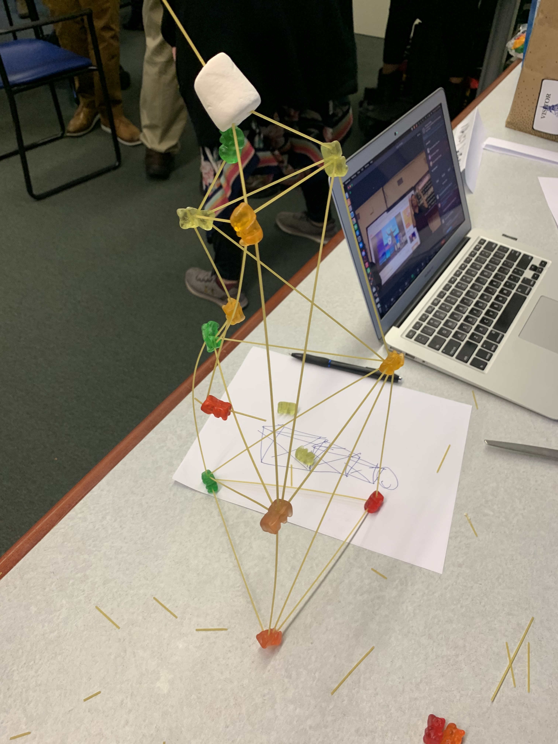

General Updates
Board Training
NASRA
Maryland Relay Manager Report

Slide 13
General Updates
The Fall of Analog Relay Services
Maryland Relay Manager Report

Slide 14
General Updates
Universal Telecommunications Access Platform
Maryland Relay Manager Report

Slide 15
Questions?

Slide 16

MAT Manager’s Report
Kevin Steffy
MAT Manager
Kevin.Steffy@Maryland.gov | 443-852-6717 (SMS)

Slide 17


General Updates
From October to December 2022, MAT has received 122 new applications and distributed a total of 133 pieces of telecommunications equipment.
In the previous quarterly report, we received 69 new applications and distributed a total of 11 pieces of telecommunications equipment.
122
69
new applications
new applications
pieces of telecommunications equipment
133
pieces of
telecommunications
equipment
11
MAT Manager Report

Slide 18

Communication Facilitator (CF)
From October to December 2022, the CF service has provided 107 services. In the previous quarterly report, we provided 60 services.
The video conference calls were for committee/board/town hall meetings, webinars, interviews, memorial services, alcoholics anonymous meetings, VP calls, and training.
As of today, we have 11 DeafBlind users.
MAT Manager Report

Slide 19
Oregon’s CF Program
Effective Program Date: January 2, 2023
Rates for facilitators (weekday, night, weekend, last minute, facilitate, protactile (PT), legal, or medical).
Training for facilitators (facilitating, PT, legal, and medical)
MAT Manager Report

Slide 20
Questions?

Slide 21
Public Relations & Outreach Report
Donna Broadway-Callaman
Community Outreach Manager
DonnaT.Broadway-Callaman@Maryland.gov | 443-240-9969

Slide 22
What’s New With Maryland Relay?
We are currently in our preparation season. We recently attended Winter MACO in Cambridge where we made a bunch of good connections and we are even scheduled to meet with Senator Cheryl Kagan, from Montgomery County to talk about our program and give information.
We are continuing to prepare for a few major events including:
  Northeast Maryland Senior Conference
  St. Elizabeth School Special Needs Fair
  B’More Healthy Expo
  Blind Health Expo
  And several exhibits at the various branches of the Baltimore County Public Library
Public Relations & Outreach Report

Slide 23
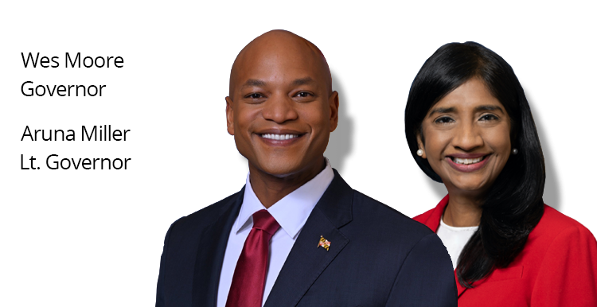

What’s New With Maryland Relay?
We are working closely with the teams at MDoD, namely Yesheva Kelly, and DoIT to migrate from our old platform onto the MDoD platform. This is intended as a temporary, holdover website until we get our permanent website. Date is TBD.
Governor Wes Moore was sworn in last Wednesday, January 18th and I will insert any big initiatives he has done with public affairs, wording, etc. anything that can affect our outreach.
Public Relations & Outreach Report

Slide 24
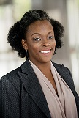
What’s New With Maryland Relay?
Tarita Turner’s (TRS Outreach Coordinator) last day was in November.
Jenny Pearson is still with Hamilton and is helping the outreach team until we have a suitable replacement.
Hamilton has access to Tarita’s email so we won’t miss any events she may have scheduled before her departure.
I want to take this time to formally thank Tarita for her hard work and dedication to Maryland Relay. She was with us for many years and is a valued part of our team. We wish her the best of luck with her future endeavors.
Public Relations & Outreach Report

Slide 25



What’s New With Maryland Relay?
At our last meeting, I discussed increasing our visibility using social media.
Former Governor Larry Hogan banned the use of TikTok on government devices. We will not be using TikTok but will continue to use our existing platforms to create content that promotes our programs and various phones and equipment, as well as statewide awareness days and initiatives.
Outreach has a designated email, tam.outreach@Maryland.gov, that we will use for RSVP’s and special outreach projects.
@MDRelay711
facebook.com/
MarylandRelay711
@MDRelay711
Public Relations & Outreach Report

Slide 26
Continued Outreach Efforts
Advertising
Webinars
Mailings
Virtual/Hybrid Events
Networking/Making New Contacts
Field Visits
Television ads/
paid segments
Public Relations & Outreach Report

Slide 27
Questions?

Slide 28


Hamilton Relay
Updates

Slide 29
Maryland TRS
Percent Answered in 10 seconds
Hamilton Relay Report

Slide 30
Maryland Captioned Telephone
Percent Answered in 10 seconds
Hamilton Relay Report

Slide 31
Maryland TRS
Session & Conversation Minutes
Hamilton Relay Report

Slide 32
Maryland Captioned Telephone
Session & Conversation Minutes
Hamilton Relay Report

Slide 33
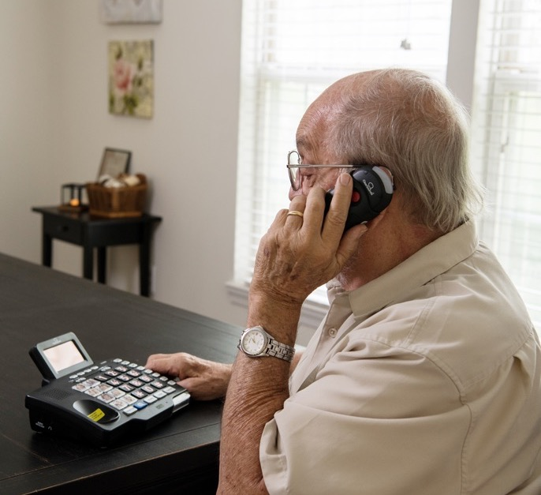
Maryland TRS
Customer Care Contacts
 | Sept | Oct | Nov
Technical | 0 | 0 | 0
General Information | 7 | 5 | 3
Equipment | 0 | 4 | 3
Customer Profile | 2 | 1 | 0
Outreach Requests | 0 | 0 | 0
Operations Complaints | 0 | 0 | 0
External Complaints | 0 | 0 | 0
Wrong Number/Hang Up | 30 | 54 | 29
Compliments/Commendations | 0 | 0 | 0
Malicious Caller | 0 | 0 | 0
Hamilton Relay Report

Slide 34
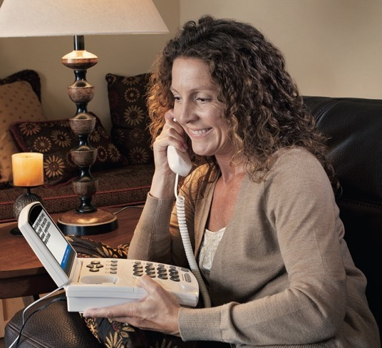
Maryland Captioned Telephone
Customer Care Contacts
 | Sept | Oct | Nov
Service | 0 | 0 | 0
Technical | 0 | 0 | 0
Product | 0 | 0 | 0
Billing | 0 | 0 | 0
Setup | 0 | 2 | 0
Info/Referral/Ed | 0 | 0 | 0
Other | 0 | 0 | 0
Hamilton Relay Report

Slide 35
Outreach Statistics
36 Presentations/
webinars
45 Exhibits
20 Networking
18 Meetings
2 Sponsorships
Hamilton Relay Report

Slide 36
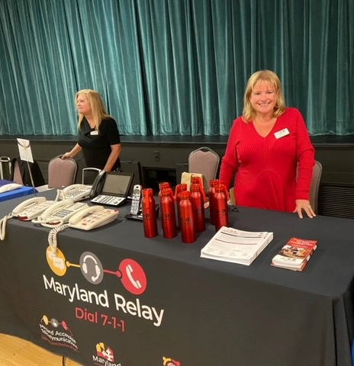
CTS Highlights
In September, Jenny attended the Heritage Women’s Club Annual Health and Wellness Fair in Annapolis, MD. It was the first time back in person after 2 years and folks were very interested to learn more about Maryland Relay.
Hamilton Relay Report

Slide 37
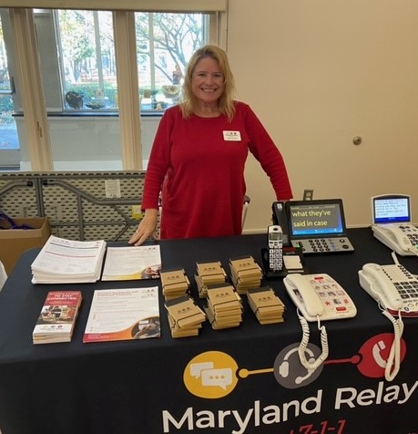
CTS Highlights
In October, Jenny attended the Mid-Atlantic ADA Conference in Alexandria, VA.
In November, Jenny attended the Myerberg Senior Center’s Veteran’s Day Celebration in Pikesville, MD.
Hamilton Relay Report

Slide 38
RTT Highlights
Photo of behind the scenes processing of 911 calls?
From September through November:
  We exhibited at 8 different expos, including the State Sheriff’s Conference, the fall Mid-Atlantic APCO event, and various health fairs and veteran events
  Completed 24 webinars which resulted in two additional PSAPs being fully trained in Maryland
  In September, we had the privilege of touring the Harford County PSAP in-person and seeing the behind-the-scenes processing of 911 calls (PHOTO?)
Hamilton Relay Report

Slide 39

RTT Highlights
From September through November:
  In October, we established a partnership with the CAN Transitional Shelter in Baltimore County, resulting in several in-person presentations for their center
  Attended over 15 networking events targeting veterans, seniors, the Speech Disability Community and emergency personnel.
Hamilton Relay Report

Slide 40

We’d love to see you!
We’d love to see you at some of the upcoming events we will be attending.
Please reach out to the outreach team if you would like us to attend an event that’s important to your community. It would be out pleasure to come out and share resources.
Rebecca Miller
MARYLAND RTT OUTREACH COORDINATOR
Rebecca.Miller@HamiltonRelay.com
We would love to partner with you!

Slide 41
Questions?

Slide 42
Thank you!
January 26, 2023

